Slide 1
Project pm
Saving Electricity

Slide 2
* The Organization for Economic Co-operation and Development
Warns that given the current trends, energy-related emissions will
increase by 70% by 2050.this can accelerate the negative consequences of the climate change including higher temperatures
And a rise in the frequency of extreme weather events.
Why did the ministry of electricity decide to make this application?
this app enable :
1- to control of your home electricity from any place.
2- to be attached with the all devices at your home .
3- you can turn on/off any devices you want from any
place even if you are out of home.
4- will see you which devices are turned on and which turned off.
5- you can pay the electricity bill with the app.
Purpose

Slide 3
500.000$.
1- the project must take a year.
2- the project must not exceed 500.000$.
3- laptops and computers must be bought from dell company.
This application can run only on the IOS and Android operation system.
1-A team of electrical engineering.
2-A team of programing.
3-Device of receiver
Budget
Constraints
Assumptions
Project resources

Slide 4
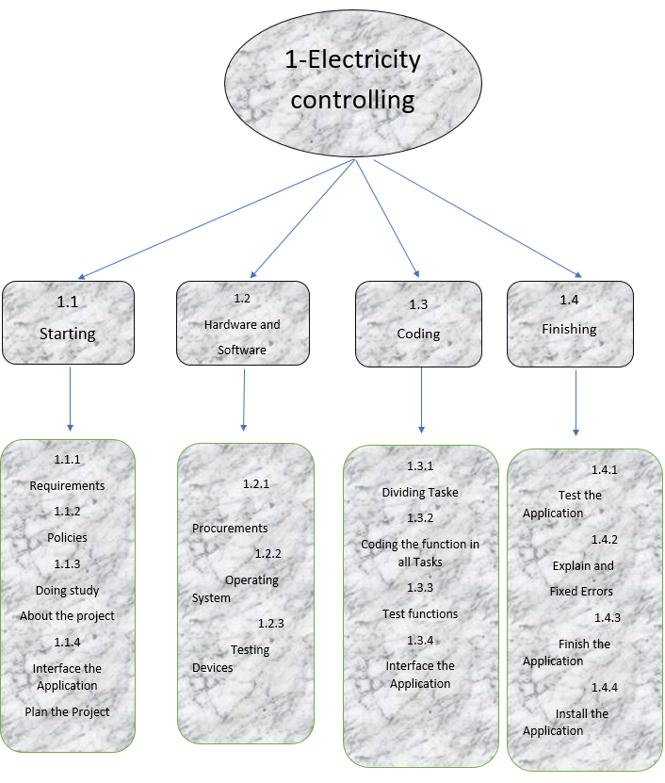
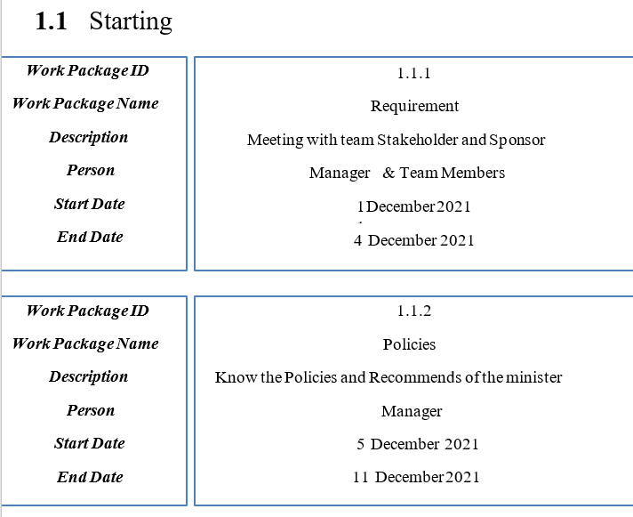
WBS
WBS dictionary

Slide 5
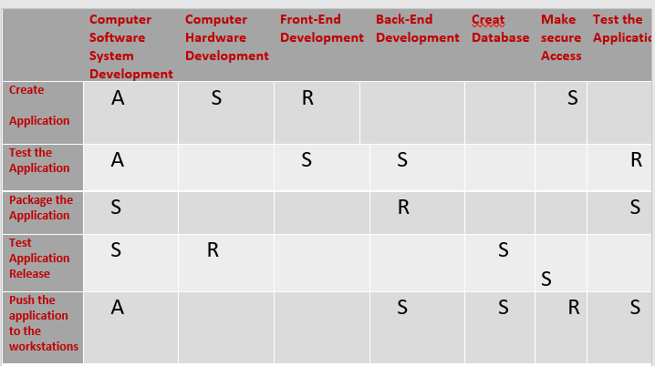
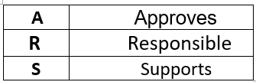
Responsibility Matrix

Slide 6
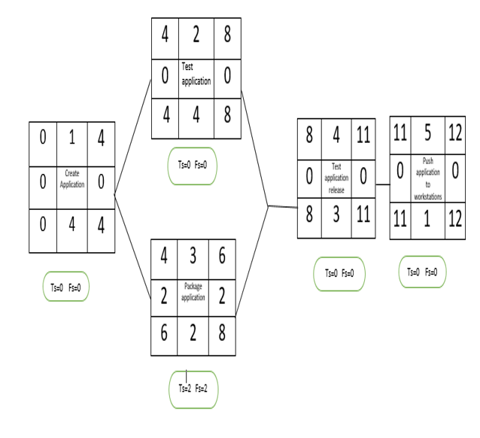
Network

Slide 7
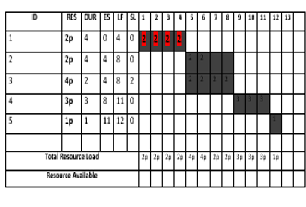
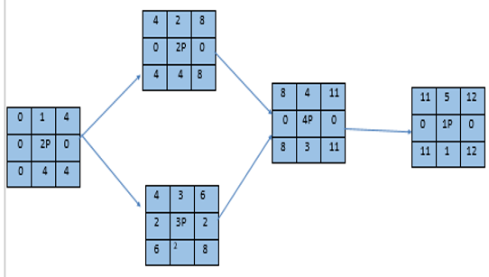
Resource Constrained

Slide 8
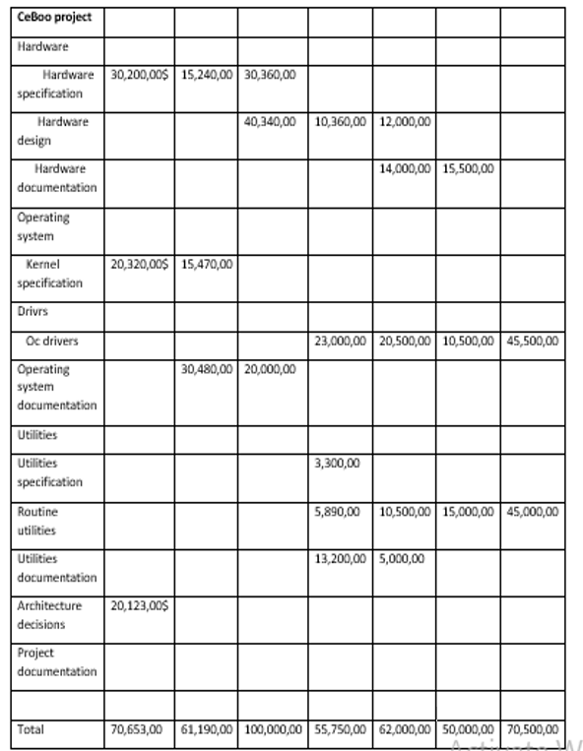
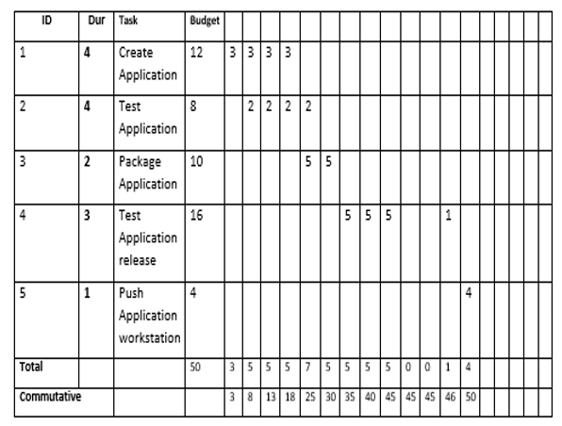
Matrix of activity cost
Baseline Budget

Slide 9
The risk of project
1-The lack of efficiency sufficient in the receiver.
2-Funders’ dissatisfaction with profits and results.
3-Increase in the cost.
4-Lightning and thunder damage which leads to a lot of damages in receiver.
5-Damages in equipment and devices comes from both direct and indirect lightning strikes.
How we deal with these risks?
1-Using equipment that withstands high pressure of electricity to
withstand the impact of lightning and thunder.
2-Using efficient receivers with insulators to withstand this great pressure.

Slide 10
How we monitor our project?
1-Projects meetings (weekly or daily).
2-Individual catchups with team.
3-Timely updates on tasks.
4-Weekly status reports.
5.Timely completion of timesheets

